Slide 1
MODULE FOUR: GPU PROGRAMMING
Speaker, Date
Notes:
GPU programming is a very popular form of parallel programming. In terms of OpenACC, it is generally more difficult than multicore programming.

Slide 2
MODULE OVERVIEW
OpenACC Directives
Multicore CPU vs GPU
Introduction to GPU Data Management
CUDA Managed Memory
GPU Profiling with Nsight Systems

Slide 3
CPU VS GPU
Notes:
Our multicore implementation for our code is mostly done. There are very few additional optimizations we can do.
Now we’re moving into GPU programming. First, we will define the difference between a CPU and a GPU. Our focus is to give the students enough knowledge to get the code running on a GPU.

Slide 4
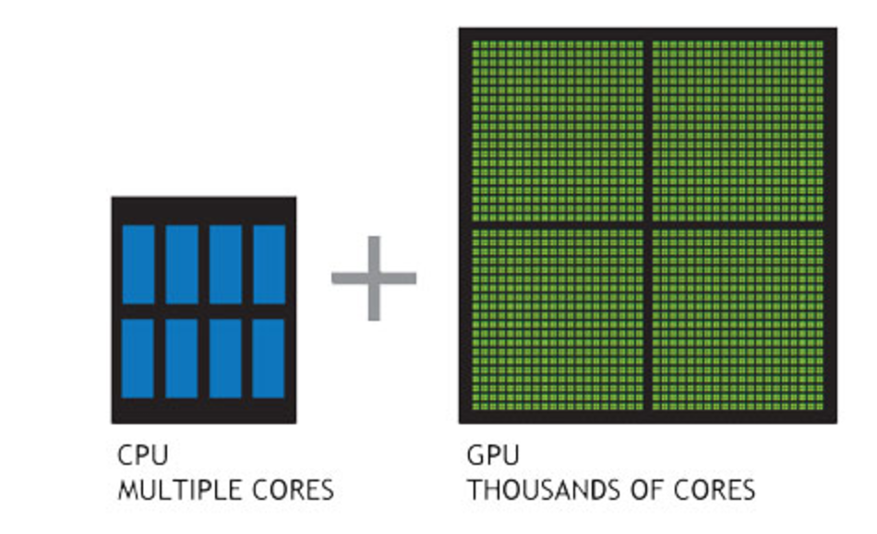
CPU VS GPU
Number of cores and parallelism
Both are extremely popular parallel processors, but with different degrees of parallelism
CPUs generally have a small number of very fast physical cores
GPUs have thousands of simple cores able to achieve high performance in aggregate
Both require parallelism to be fully utilized, but GPUs require much more
Notes:
Almost all modern CPUs have multiple cores. They can run sequential code very quickly due to their high clock speeds and large caches, but still require multiple threads of execution, each using SIMD vector instructions in order to fully utilize the hardware.
CPUs: Small number of cores, short SIMD vectors, very fast clocks
A GPU (Graphical Processing Unit) is designed to have more simple cores. GPU cores run at a lower clock speed and lack many of tricks a CPU core utilizes, but because there are so many of them you can obtain higher aggregate performance if you give the GPU enough parallelism.
GPUS: Large number of cores with clocks slower than CPUs, but much higher performance in aggregate

Slide 5



CPU + GPU WORKFLOW
Application Code
Application Code
GPU
CPU
Compute-Intensive Functions
Rest of Sequential
CPU Code
Small % of Code
Large % of Runtime
Notes:
The goal when using a GPU is to be able to run our computationally intensive code (our large for loops) in a highly parallel matter. Since the GPU is not good at running sequential code, we will run all of our sequential code on the CPU and only run our parallel code on the GPU. This parallel code often takes up a very small portion of the code (small as in only a few lines of code), so when parallelizing our code, we often leave a large portion of the code un-altered.

Slide 6

GPU PROGRAMMING IN OPENACC
Execution always begins and ends on the host CPU
Compute-intensive loops are offloaded to the GPU using directives
Offloading may or may not require data movement between the host and device.
int main(){
<sequential code>
#pragma acc kernels
{
<parallel code>
}
}
Compiler
Hint
Notes:
We’ve seen how we can use OpenACC directives to parallelize our loops on a multicore CPU. Parallelization for the GPU is very similar (at least as far the programmer is concerned), but may require the programmer think about how the data is accessed to reduce the amount of data that needs to transfer between the host and GPU memory.

Slide 7
CPU + GPU
Physical Diagram
CPU
GPU
CPU memory is larger, GPU memory has more bandwidth
CPU and GPU memory are usually separate, connected by an I/O bus (traditionally PCI-e)
Any data transferred between the CPU and GPU will be handled by the I/O Bus
The I/O Bus is relatively slow compared to memory bandwidth
The GPU cannot perform computation until the data is within its memory
$
$
$
$
$
$
$
$
$
$
$
$
Shared Cache
$
$
$
$
$
$
$
$
High Capacity Memory
Shared Cache
IO Bus
High Bandwidth Memory
Notes:
The CPU and GPU memory are completely separate. The CPU and GPU can only access their own memory. Before doing any computation on the GPU, the data must first be within the GPU memory.
This is a bit of an oversimplification, since it’s often possible to operate on the opposite memory, it’d just rarely desirable to do so.

Slide 8
BASIC DATA MANAGEMENT
Notes:
We’ll be discussing how to manage data movement with OpenACC in the next lecture, this section is only meant to motivate the need to manage data and why we’ll use CUDA Managed Memory.

Slide 9
BASIC DATA MANAGEMENT
Between the host and device
Host
Device
The host is traditionally a CPU
The device is some parallel accelerator
When our target hardware is multicore, the host and device are the same, meaning that their memory is also the same
There is no need to explicitly manage data when using a shared memory accelerator, such as the multicore target
Host Memory
Device Memory
Notes:
Programming for a multicore accelerator tends to be simpler than programming for a GPU, mostly due to the need to manage the two memories.

Slide 10
BASIC DATA MANAGEMENT
Between the host and device
CPU
GPU
When the target hardware is a GPU data will usually need to migrate between CPU and GPU memory
The next lecture will discuss OpenACC data management, for now we’ll assume a unified Host/Accelerator memory
$
$
$
$
$
$
$
$
$
$
$
$
Shared Cache
$
$
$
$
$
$
$
$
High Capacity Memory
Shared Cache
IO Bus
High Bandwidth Memory
Notes:
In this lecture, assume CUDA managed memory. In the next module (Module 5) we will discuss the proper way for the programmer to handle data management.

Slide 11
CUDA MANAGED MEMORY

Slide 12


CUDA MANAGED MEMORY
Commonly referred to as “unified memory.”
Simplified Developer Effort
Without Managed Memory
With Managed Memory
CPU and GPU memories are combined into a single, shared pool
System Memory
GPU Memory
Managed Memory
Notes:
CUDA Managed Memory is a technology that allows a single pointer to be dereferenced from either the CPU or GPU. Depending on where it’s dereferenced, the physical page of memory may need to get migrated between the two physical memories, but the user doesn’t have to think about it. For algorithms with a high degree of locality and data reuse, this may be sufficient. For other algorithms, it may result in the data being thrashed between the two physical memories.

Slide 13
CUDA MANAGED MEMORY
Usefulness
Handling explicit data transfers between the host and device (CPU and GPU) can be difficult
The PGI compiler can utilize CUDA Managed Memory to defer data management
This allows the developer to concentrate on parallelism and think about data movement as an optimization
$ pgcc –fast –acc –ta=tesla:managed –Minfo=accel main.c
$ pgfortran –fast –acc –ta=tesla:managed –Minfo=accel main.f90

Slide 14
MANAGED MEMORY
Limitations
With Managed Memory
The programmer will almost always be able to get better performance by manually handling data transfers
Memory allocation/deallocation takes longer with managed memory
Cannot transfer data asynchronously
Currently only available from PGI on NVIDIA GPUs.
Managed Memory
Notes:
With managed memory the data always arrives just too late for the first access. Programmers can generally do better by manually putting the data where it’s needed and when it’s needed.

Slide 15
OPENACC WITH MANAGED MEMORY
An Example from the Lab Code
while ( error > tol && iter < iter_max )
{
error = 0.0;
#pragma acc kernels
{
for( int j = 1; j < n-1; j++)
{
for( int i = 1; i < m-1; i++ )
{
Anew[j][i] = 0.25 * ( A[j][i+1] + A[j][i-1]
+ A[j-1][i] + A[j+1][i]);
error = fmax( error, fabs(Anew[j][i] - A[j][i]));
}
}
for( int j = 1; j < n-1; j++)
{
for( int i = 1; i < m-1; i++ )
{
A[j][i] = Anew[j][i];
}
}
}
}
Without Managed Memory the compiler must determine the size of A and Anew and copy their data to and from the GPU each iteration to ensure correctness
With Managed Memory the underlying runtime will move the data only when needed

Slide 16
INTRODUCTION TO DATA CLAUSES

Slide 17
BASIC DATA MANAGEMENT
Moving data between the Host and Device using copy
Data clauses allow the programmer to tell the compiler which data to move and when
Data clauses may be added to kernels or parallel regions, but also data, enter data, and exit data, which will discussed shortly
C/C++
#pragma acc kernels
for(int i = 0; i < N; i++){
a[i] = 0;
}

Slide 18
BASIC DATA MANAGEMENT
Moving data between the Host and Device using copy
Data clauses allow the programmer to tell the compiler which data to move and when
Data clauses may be added to kernels or parallel regions, but also data, enter data, and exit data, which will discussed shortly
C/C++
#pragma acc parallel loop copyout(a[0:n])
for(int i = 0; i < N; i++){
a[i] = 0;
}
I don’t need the initial value of a, so I’ll only copy it out of the region at the end.
Notes:
Here we included the copy(a[0:n]) in our code snippet (Fortran on the next slide.) We’ll break down how this copy clause works in the following slides.

Slide 19
BASIC DATA MANAGEMENT
Moving data between the Host and Device using copy
Data clauses allow the programmer to tell the compiler which data to move and when
Data clauses may be added to kernels or parallel regions, but also data, enter data, and exit data, which will discussed shortly
Fortran
!$acc parallel loop copyout(a(1:N))
do i = 1, N
a(i) = 0
end do
I don’t need the initial value of a, so I’ll only copy it out of the region at the end.
Notes:
Here we included the copy(a[0:n]) in our code snippet (Fortran on the next slide.) We’ll break down how this copy clause works in the following slides.

Slide 20
BASIC DATA MANAGEMENT
Moving data between the Host and Device using copy
Allocate ‘a’ on GPU
Copy ‘a’ from CPU to GPU
Execute Kernels
Copy ‘a’ from GPU to CPU
Deallocate ‘a’ from GPU
#pragma acc parallel loop copy(a[0:N])
for(int i = 0; i < N; i++){
a[i] = 2 * a[i];
}
Notes:
This is a quick step-by-step of the copy clause. It will be presented graphically in the next slide.
When managing data between the CPU and GPU, the CPU and GPU copy will be different. Though, you will refer to them with the same variable name. In this case, if you attempt to access array ‘a’ outside of the kernels region, then it will use the CPU copy. If you attempt to access array ‘a’ inside of the kernels region, it will use the GPU copy. This process is automatic. This is different than how CUDA functions (no need to separate device pointers)
The “Execute Kernels” step basically means to run our loop on the GPU.

Slide 21
BASIC DATA MANAGEMENT
Moving data between the Host and Device using copy
Allocate ‘a’ on GPU
Copy ‘a’ from CPU to GPU
Execute Kernels
Copy ‘a’ from GPU to CPU
Deallocate ‘a’ from GPU
CPU MEMORY
GPU MEMORY
A
A
A’
A’
Notes:
This is the same step-by-step as earlier. We will see how the copy clause moves data between the two memories.
A is the array prior to the execution of our loop. A’ is the array after the execution of our loop. A and A’ are the same array (same memory location), they just contain different data (different values, A[0] might not be the same value as A’[0])

Slide 22
DATA CLAUSES
copy( list ) Allocates memory on GPU and copies data from host to GPU when entering region and copies data to the host when exiting region.
Principal use: For many important data structures in your code, this is a logical default to input, modify and return the data.
copyin( list ) Allocates memory on GPU and copies data from host to GPU when entering region.
Principal use: Think of this like an array that you would use as just an input to a subroutine.
copyout( list ) Allocates memory on GPU and copies data to the host when exiting region.
Principal use: A result that isn’t overwriting the input data structure.
create( list ) Allocates memory on GPU but does not copy.
Principal use: Temporary arrays.

Slide 23
ARRAY SHAPING
Sometimes the compiler needs help understanding the shape of an array
The first number is the start index of the array
In C/C++, the second number is how much data is to be transferred
In Fortran, the second number is the ending index
copy(array[starting_index:length])
C/C++
copy(array(starting_index:ending_index))
Fortran
Notes:
Array shaping is how you specify the size of the array. If you do not specify a shape, then the compiler will try to assume the size. This works well in Fortran, since Fortran tracks the size of the array, however, it will most likely not work in C/C++. Array shaping is also the only way to copy a portion of data from the array (for example, if you only need to copy half of the array, this can be a performance boost, cutting out unnecessary copies)

Slide 24
BASIC DATA MANAGEMENT
Multi-dimensional Array shaping
copy(array[0:N][0:M])
C/C++
copy(array(1:N, 1:M))
Fortran
Notes:
This is how you shape multi-dimensional arrays. The same rules apply as the previous slide.

Slide 25
PROFILING GPU CODE
Notes:
This transition was too abrupt. Need something to ease it.

Slide 26
PROFILING GPU CODE (PGI)
Obtaining information about your GPU
Using the pgaccelinfo command will display information about available accelerators
Terminal Window
$ pgaccelinfo
Device Number: 0
Device Name: Tesla P100-PCIE-16GB
...
Managed Memory: Yes
PGI Compiler Option: -ta=tesla:cc60

Slide 27
PROFILING GPU CODE
Obtaining information about your GPU
Using the pgaccelinfo command will display information about available accelerators
Each device is numbered starting with 0
Terminal Window
$ pgaccelinfo
Device Number: 0
Device Name: Tesla P100-PCIE-16GB
...
Managed Memory: Yes
PGI Compiler Option: -ta=tesla:cc60

Slide 28
PROFILING GPU CODE
Obtaining information about your GPU
Using the pgaccelinfo command will display information about available accelerators
Each device is numbered starting with 0
The Device Name identifies the type of accelerator
Terminal Window
$ pgaccelinfo
Device Number: 0
Device Name: Tesla P100-PCIE-16GB
...
Managed Memory: Yes
PGI Compiler Option: -ta=tesla:cc60

Slide 29
PROFILING GPU CODE
Obtaining information about your GPU
Using the pgaccelinfo command will display information about available accelerators
Each device is numbered starting with 0
The Device Name identifies the type of accelerator
Can Managed Memory be used?
Terminal Window
$ pgaccelinfo
Device Number: 0
Device Name: Tesla P100-PCIE-16GB
...
Managed Memory: Yes
PGI Compiler Option: -ta=tesla:cc60

Slide 30
PROFILING GPU CODE
Obtaining information about your GPU
Using the pgaccelinfo command will display information about available accelerators
Each device is numbered starting with 0
The Device Name identifies the type of accelerator
Can Managed Memory be used?
What compiler options should be used to target this device?
Terminal Window
$ pgaccelinfo
Device Number: 0
Device Name: Tesla P100-PCIE-16GB
...
Managed Memory: Yes
PGI Compiler Option: -ta=tesla:cc60
Without Manage Memory
$ pgcc –ta=tesla:cc60 main.c
With Manage Memory
$ pgcc –ta=tesla:cc60,managed main.c

Slide 31
COMPILING GPU CODE
Terminal Window
$ pgcc –fast –ta=tesla:cc60 –Minfo=accel jacobi.c laplace2d.c
calcNext:
37, Generating copy(Anew[:m*n],A[:m*n])
Accelerator kernel generated
Generating Tesla code
37, Generating reduction(max:error)
38, #pragma acc loop gang /* blockIdx.x */
41, #pragma acc loop vector(128) /* threadIdx.x */
41, Loop is parallelizable
swap:
56, Generating copy(Anew[:m*n],A[:m*n])
Accelerator kernel generated
Generating Tesla code
57, #pragma acc loop gang /* blockIdx.x */
60, #pragma acc loop vector(128) /* threadIdx.x */
60, Loop is parallelizable
We can see that our data copies are being applied by the compiler

Slide 32
COMPILING GPU CODE
Terminal Window
$ pgcc –fast –ta=tesla:cc60 –Minfo=accel jacobi.c laplace2d.c
calcNext:
37, Generating copy(Anew[:m*n],A[:m*n])
Accelerator kernel generated
Generating Tesla code
37, Generating reduction(max:error)
38, #pragma acc loop gang /* blockIdx.x */
41, #pragma acc loop vector(128) /* threadIdx.x */
41, Loop is parallelizable
swap:
56, Generating copy(Anew[:m*n],A[:m*n])
Accelerator kernel generated
Generating Tesla code
57, #pragma acc loop gang /* blockIdx.x */
60, #pragma acc loop vector(128) /* threadIdx.x */
60, Loop is parallelizable
We also see that the compiler is generating code for our GPU

Slide 33
COMPILING GPU CODE
Terminal Window
$ pgcc –fast –ta=tesla:cc60 –Minfo=accel jacobi.c laplace2d.c
calcNext:
37, Generating copy(Anew[:m*n],A[:m*n])
Accelerator kernel generated
Generating Tesla code
37, Generating reduction(max:error)
38, #pragma acc loop gang /* blockIdx.x */
41, #pragma acc loop vector(128) /* threadIdx.x */
41, Loop is parallelizable
swap:
56, Generating copy(Anew[:m*n],A[:m*n])
Accelerator kernel generated
Generating Tesla code
57, #pragma acc loop gang /* blockIdx.x */
60, #pragma acc loop vector(128) /* threadIdx.x */
60, Loop is parallelizable
This is the parallelization of the inner loop
This is the parallelization of the outer loop

Slide 34
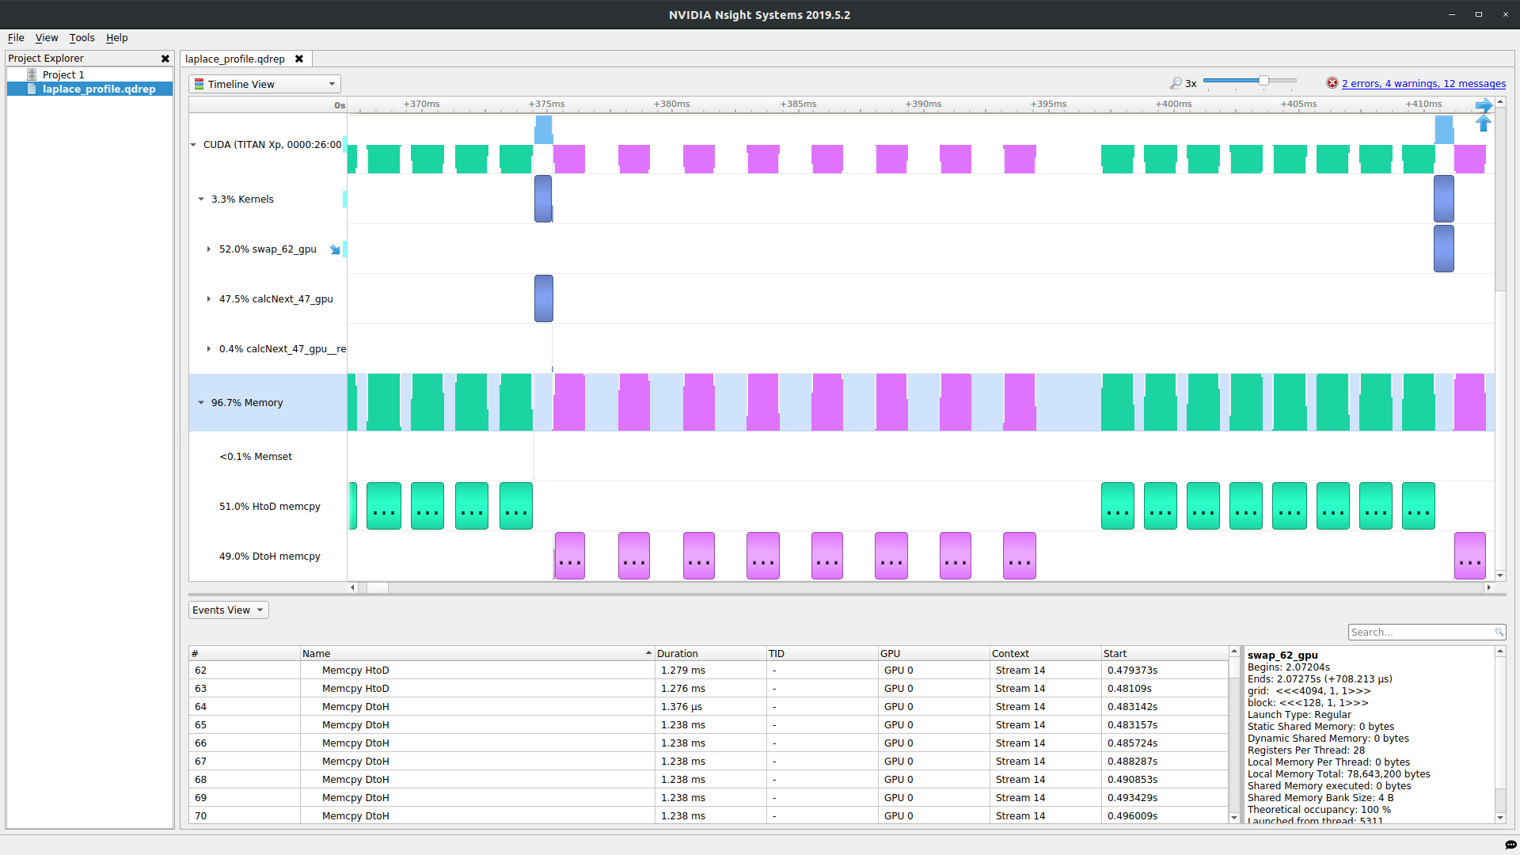
PROFILING GPU CODE (Nsight Systems)
Using nsys to profile GPU code
Nsight Systems presents far more information when running on a GPU
It is capable of capturing information about CUDA execution in the profiled process.
In the Timeline view, you can see all the information about kernels and memory movements (expand the CUDA row)

Slide 35
PROFILING GPU CODE (Nsight Systems)
Using nsys to profile GPU code
Kernels: These are our computational functions. We can see our calcNext and swap function
MemCpy(HtoD): This includes data transfers from the Host to the Device (CPU to GPU)
MemCpy(DtoH): These are data transfers from the Device to the Host (GPU to CPU)

Slide 36
PROFILING GPU CODE
Receiving unexpected code results
Here we can see the runtime of our application: 151 seconds
The program is now performing over 3 times worse than the sequential version
A profiler can help us understand why this performance is worse
Terminal Window
$ pgcc –ta=tesla:cc60 jacobi.c laplace2d.c
$ ./a.out
0, 0.250000
100, 0.002397
200, 0.001204
300, 0.000804
400, 0.000603
500, 0.000483
600, 0.000403
700, 0.000345
800, 0.000302
900, 0.000269
total: 151.772627 s

Slide 37
PROFILING GPU CODE
Inspecting the Nsight Sytems timeline
Let’s focus on the data movement (Memory row)
At a first glance, it looks like our program is spending a significant amount of time transferring data between the host and device
We also see that the compute regions are very small and spread out
What if we try Managed Memory?

Slide 38
PROFILING GPU CODE
Using managed memory
Terminal Window
Using managed memory drastically improves performance
This managed memory version is performing over 20x better than the sequential code
What does the profiler tell us about this?
$ pgcc –ta=tesla:cc60,managed jacobi.c laplace2d.c
$ ./a.out
0, 0.250000
100, 0.002397
200, 0.001204
300, 0.000804
400, 0.000603
500, 0.000483
600, 0.000403
700, 0.000345
800, 0.000302
900, 0.000269
total: 1.474951 s

Slide 39
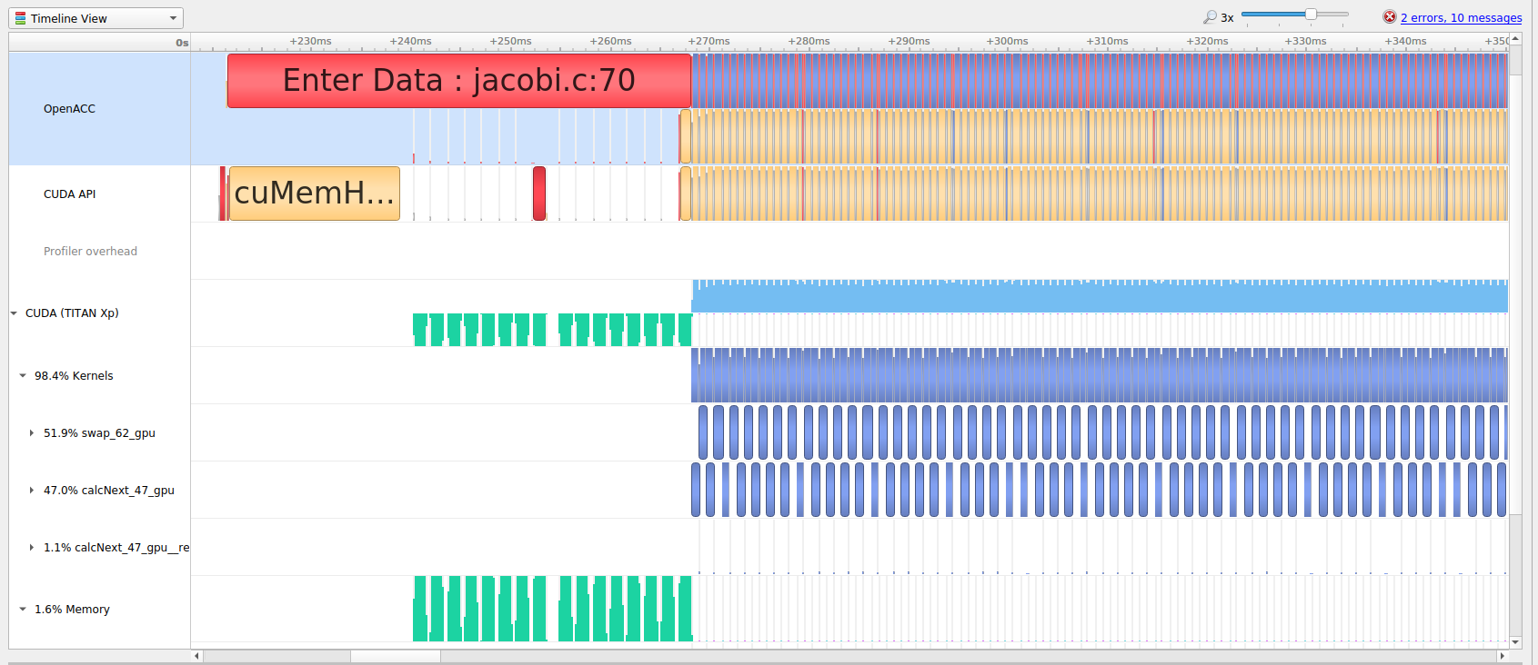
PROFILING GPU CODE
Using managed memory
The data no longer needs to transfer between each kernel
The data is only moved when it’s first accessed on the GPU or CPU
During the timestepping data remains on the device
Now a higher percentage of time is spent computing

Slide 40
KEY CONCEPTS
In this module we discussed…
The fundamental differences between CPUs and GPUs
Assisting the compiler by providing information about array sizes for data management
Managed memory

Slide 41
THANK YOU

Slide 42

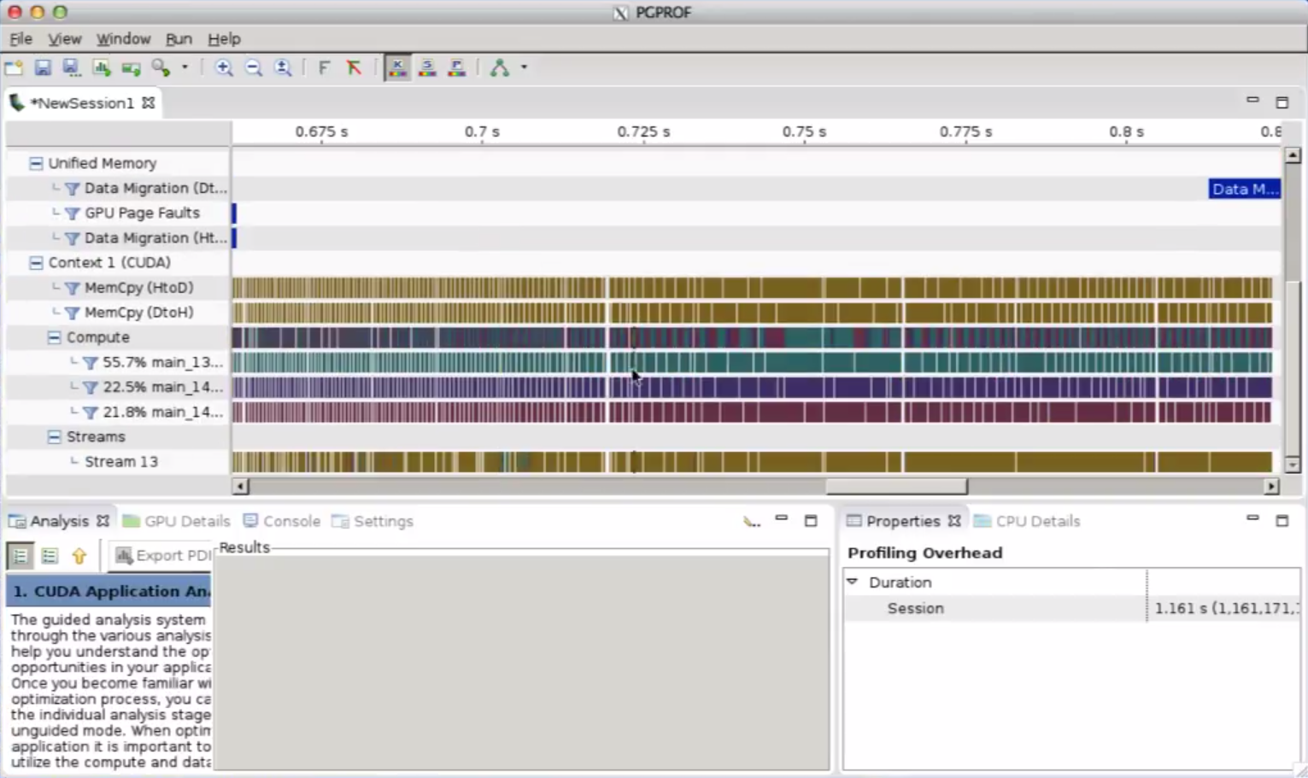
ADDITIONAL RESOURCES
YouTube OpenACC Introduction Series by Michael Wolfe
Introduction to Parallel Programming with OpenACC – Part 3
Introduction to Parallel Programming with OpenACC – Part 4
Follow along by downloading the code here!
Notes:
The two links are the name of the video. If you search with that name on YouTube, it should be easy to find. Uploaded by the YouTube account “OpenACC”
The code link leads to the OpenACCUsersGroup github.

